Slide 1


Webscraping of
Zofia Broszczak (446277)
Anna Lorenz (429840)
Webscraping and Social Media Scraping
Data Science & Business Analytics
April 8, 2025

Slide 2
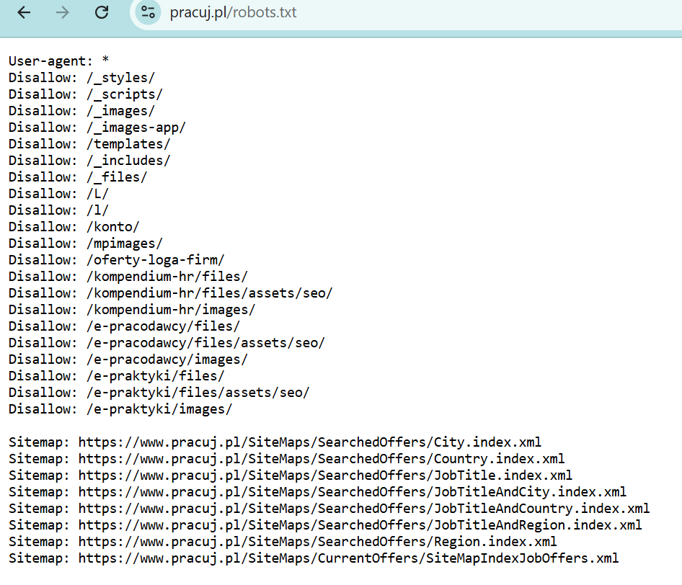

Ethical considerations
Robots.txt: Terms of Use:
The only Terms of Service file was for the provision of services on the website.
In other related documents (Privacy Policy and Your Rights) there was no information regarding scraping or any related concepts or keywords.

Slide 3


Slide 4
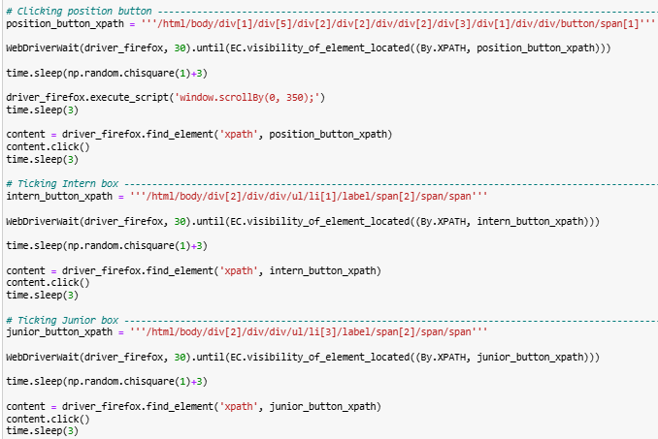
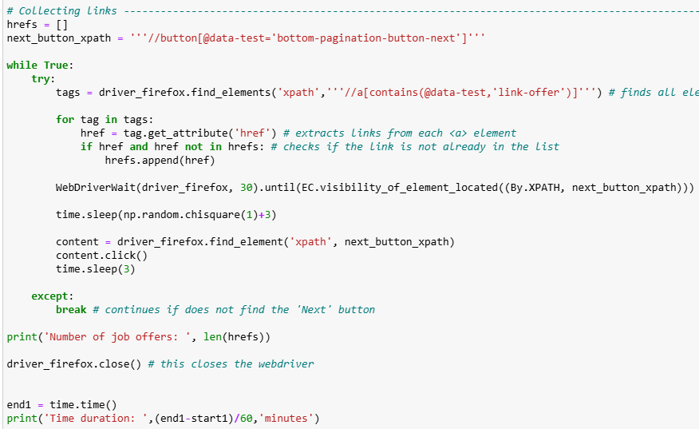

Dynamic scraping – code snippets

Slide 5
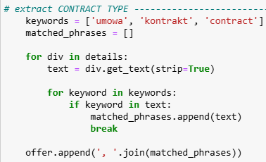
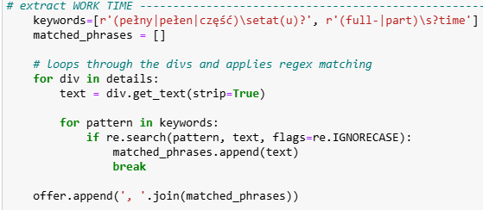
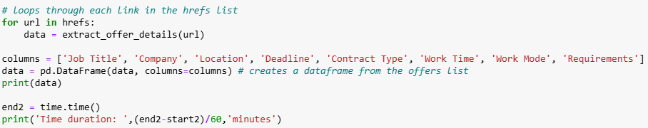
Static scraping – code snippets
Packages used: requests, bs4, re, pandas

Slide 6
Final dataset
Job Title | Company | Location | Deadline | Contract Type | Work Time | Work Mode | Requirements
Power Apps Developer | CLOUDICA sp. z o.o.About the company | Aleje Jerozolimskie 123A, Ochota, Warszawa | valid for 24 days | B2B contract | full-time | full office work, hybrid work | Minimum of 2-3 years of hands-on experience in creating Power Platform solutions, including Power Apps (Canvas and Model-Driven Apps), Power Automate, or Logic Apps., Self-motivated with a drive to build high-quality solutions...
Deployment Strategist | AICONIC PROSTA SPÓŁKA AKCYJNAAbout the company | Polna 50, Śródmieście, Warszawa | valid for a month | B2B contract | full-time | home office work, hybrid work | Ca. 2 years of experience in technical or management consultancy within reputable firms, preferably in strategic consulting, digital transformation, or AI/ML., Proven track record in managing technical consultancy projects, ensuring delivery with a full understanding of clients’ needs and creation of tailored strategies.,...
Administrator / Administratorka Big Data | Wirtualna Polska Media S.A.O firmie | Żwirki i Wigury 16, Włochy, Warszawa | ważna jeszcze miesiąc | umowa o pracę, kontrakt B2B | pełny etat | praca hybrydowa | znajomość i doświadczenie w pracy z systemem Linux (rodzina RedHat), doświadczenie z dowolnym narzędziem automatyzacji (chef, ansible, puppet, etc.), doświadczenie w technologiach BigData (np. druid, clickhouse, hadoop, etc.), ….
Data Warehouse Developer | Connectis_O firmie | Warszawa | ważna jeszcze 19 dni | kontrakt B2B | pełny etat | praca hybrydowa | Minimum 5 lat doświadczenia jako Ekspert(ka)/Programista(ka) Hurtowni Danych., SQL – co najmniej 3 lata doświadczenia potwierdzone certyfikatem, SSIS – 2 lata., ...
Backend Engineer (Python) | AICONIC PROSTA SPÓŁKA AKCYJNAAbout the company | Polna 50, Śródmieście, Warszawa | valid for a month | B2B contract | full-time | home office work, hybrid work | Python - at least 2 years of production experience, Ability to develop APIs in FastAPI, Use of best practices: testing, code formatters, typing, Pydantic, Practical knowledge of Docker,...
Data Engineer - DataOps Team | C&FAbout the company | Warszawa | valid for 10 days | contract of employment, B2B contract | full-time | home office work, hybrid work | 2+ years of experience in a similar role, including support phases of projects, hypercare, testing, and sign-offs, Proficiency in SQL and general database concepts, Ability to analyze data for anomalies, trend analysis, quality issues, and problems related to timeliness and availability, Ability to analyze ETL code to understand mappings or identify potential errors, ...
.
.
~ 250 observations

Slide 7

Thank you

